Slide 1
Water Level Sensors
in Environmental Science

Slide 2
Understanding the Water Cycle with Water Level Sensors
Middle School Level

Slide 3
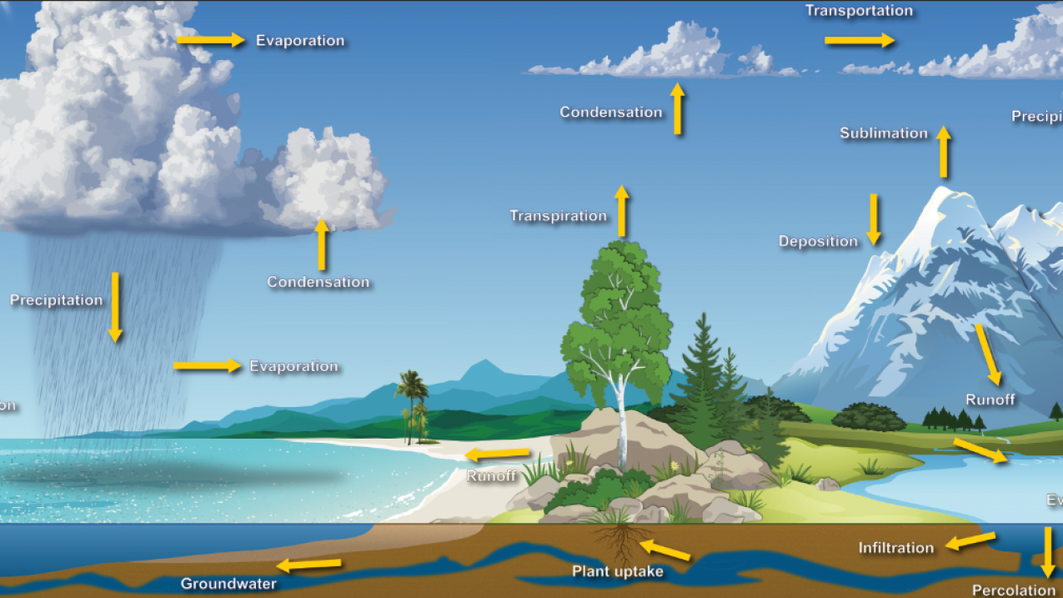
What is the Water Cycle?
The water cycle is a system that shows you that the water on Earth is constantly moving and changing its state of matter.

Slide 4
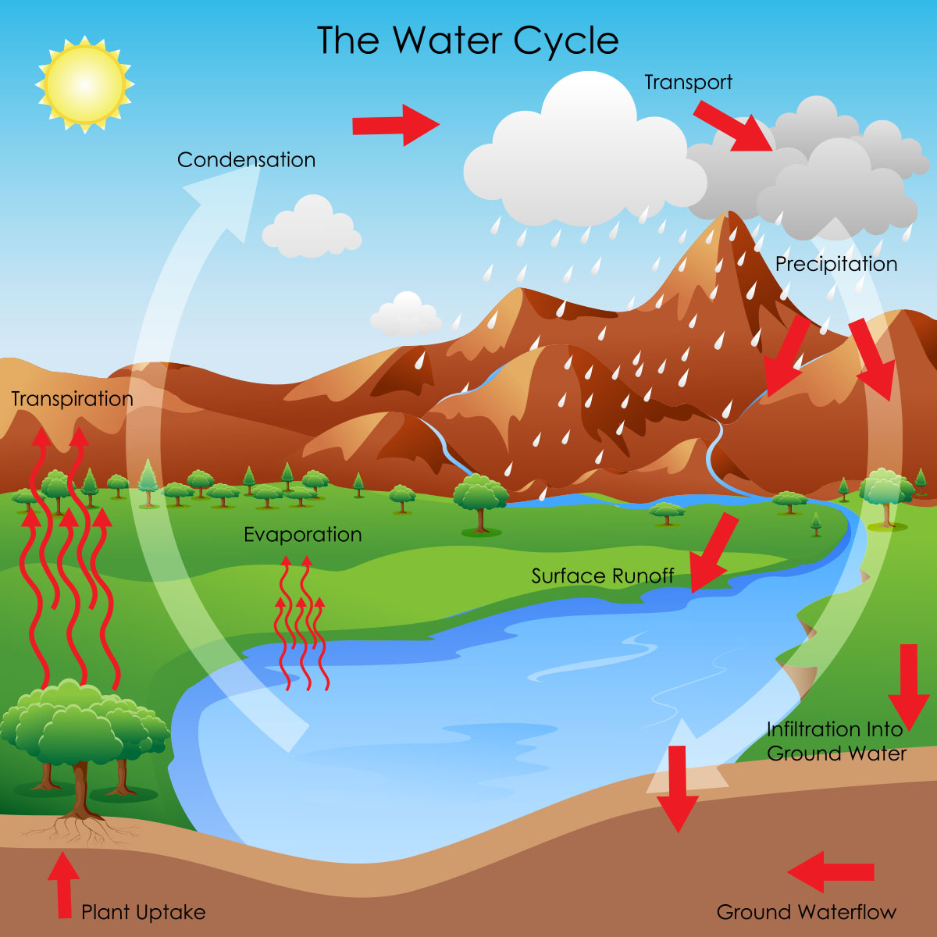
What are the Stages of the Water Cycle?
Evaporation - This is where liquid water in places like oceans, rivers, and lakes heat up so much that it turns into a gas called water vapor.
Condensation - When the water vapor begins to rise, it also starts to cool causing the gas vapor to turn back into a liquid. This liquid groups together to form a cloud or ice crystals.
Precipitation - When the water droplets begin to get heavy they start to fall back to Earth in the form of rain, snow, sleet, or hail.
Runoff - Once the precipitation has reached land it may begin to flow down hills and back into bodies of water like lakes, rivers, streams, and then eventually the ocean.
Repeat

Slide 5
How Can We Measure the Changes of the Water Cycle in a Classroom?
Activity 1:
By using a water level sensor we can simulate evaporation. You can do this by filling a bowl or container with water and placing outside with the water level sensor attached. The students will get to measure how water level drops slowly over sunny days and will be able to link the disappearing water to evaporation rather than leaks or absorption.

Slide 6
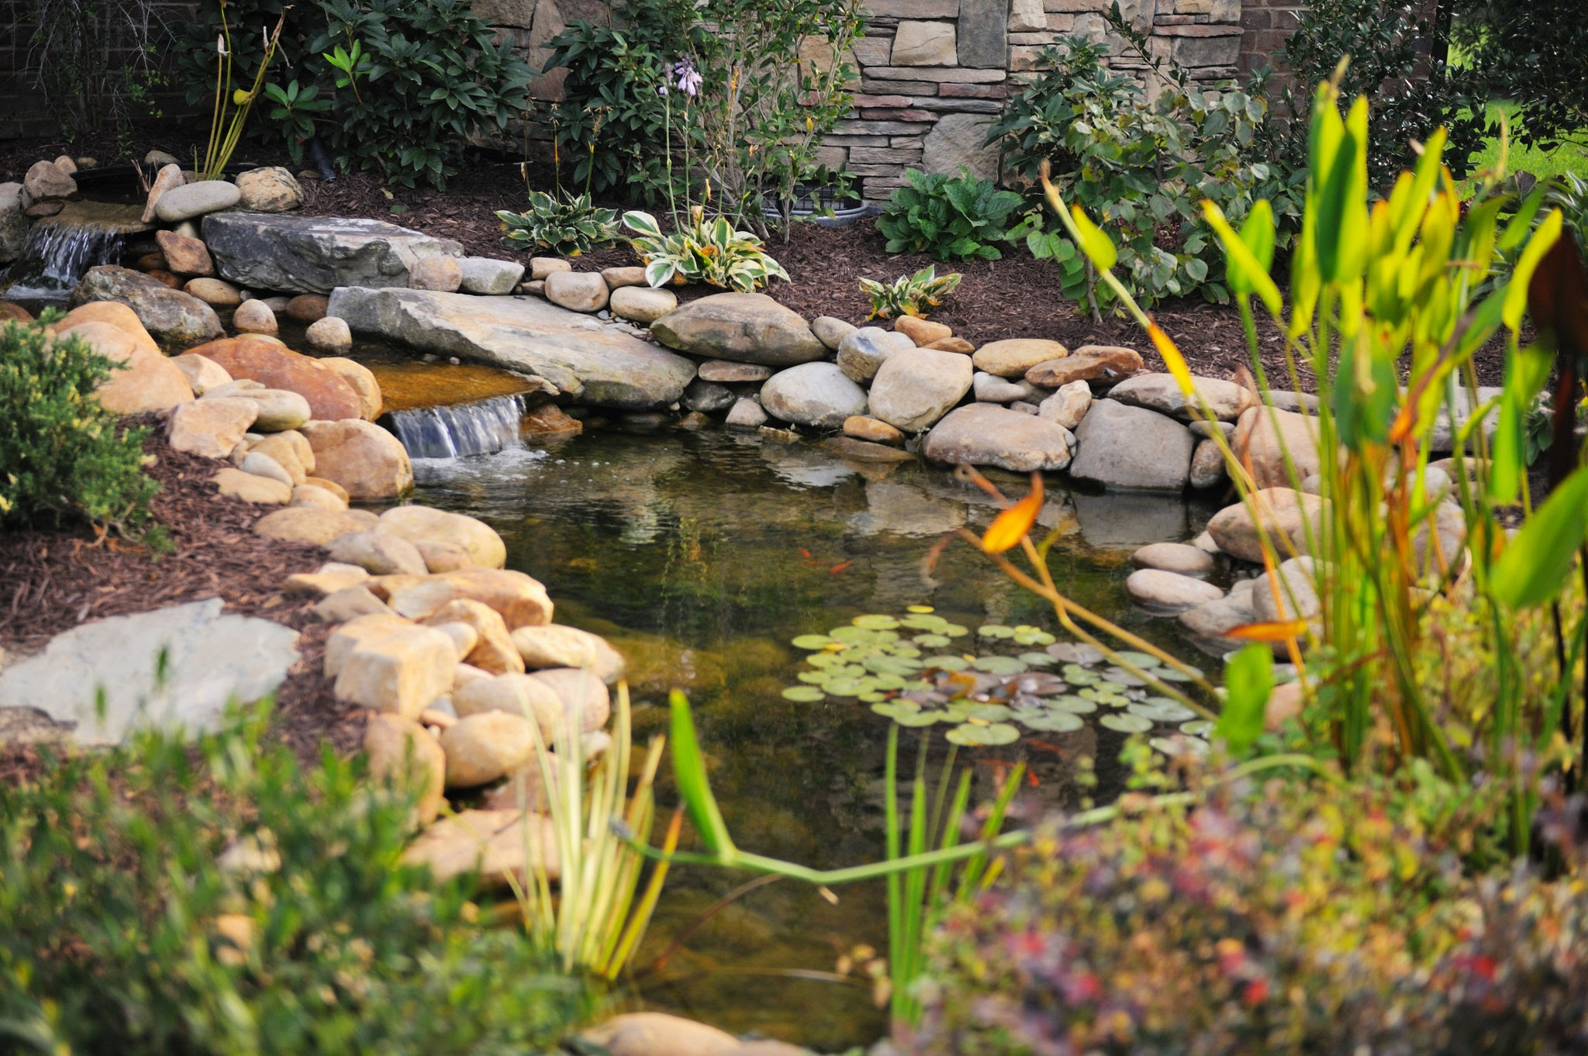
How Can We Measure the Changes of the Water Cycle in a Classroom?
Activity 2:
Using the water level sensor we can track daily water level changes in places like ponds, wetlands, or in a simulated tank. This would demonstrate that water is constantly moving into and out of storage places in the environment. Students will be able to connect the rise of water level to precipitation or runoffs and the drop of water level to evaporation.

Slide 7
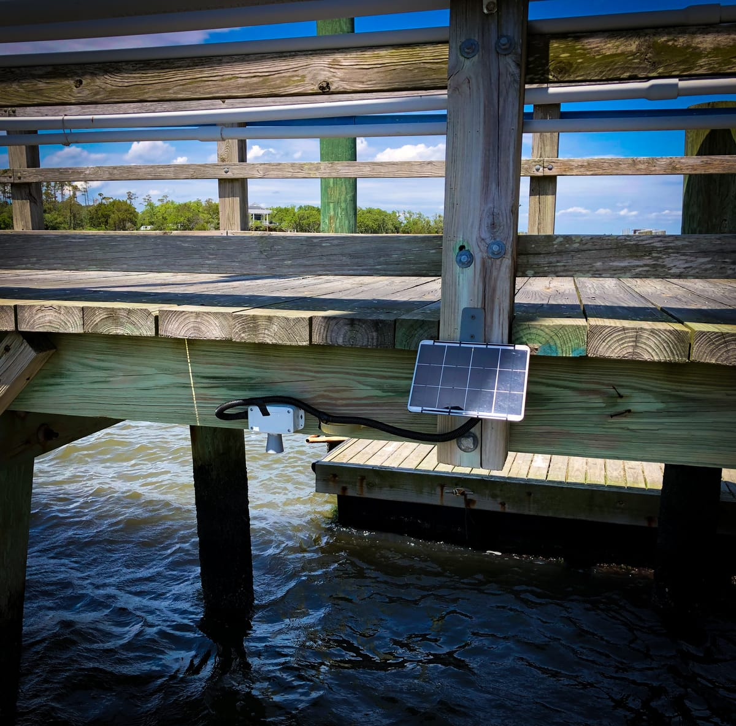
How the Sensor Helps
The IO Rodeo water level sensor helps students:
Measure water in a clear tank to simulate rainfall
Track evaporation by watching water levels drop
See how water flows in a model of hills or a schoolyard
Collect real data to understand runoff and drainage

Slide 8
Understanding the Floods and Climate Change with a Water Level Sensor
Middle School Level

Slide 9
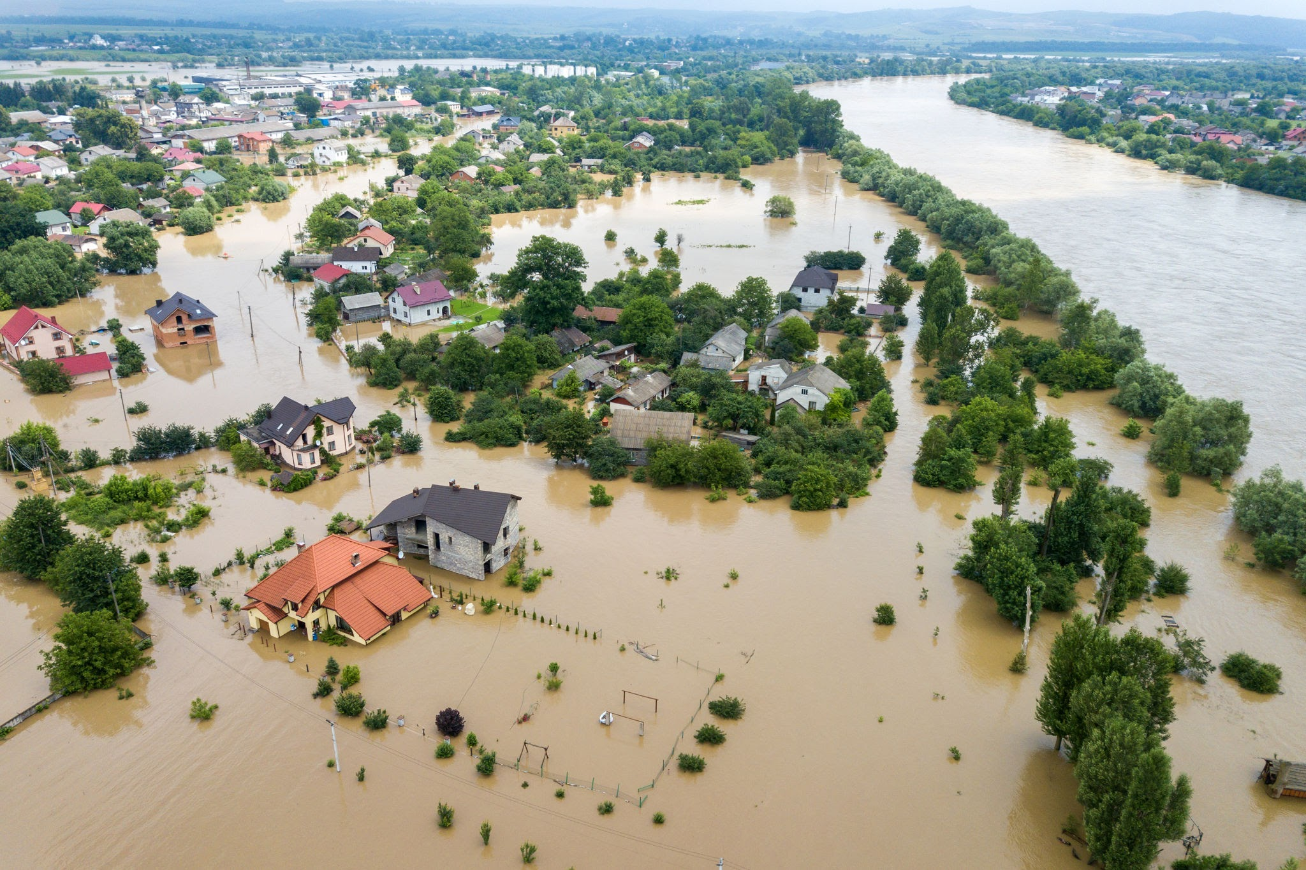
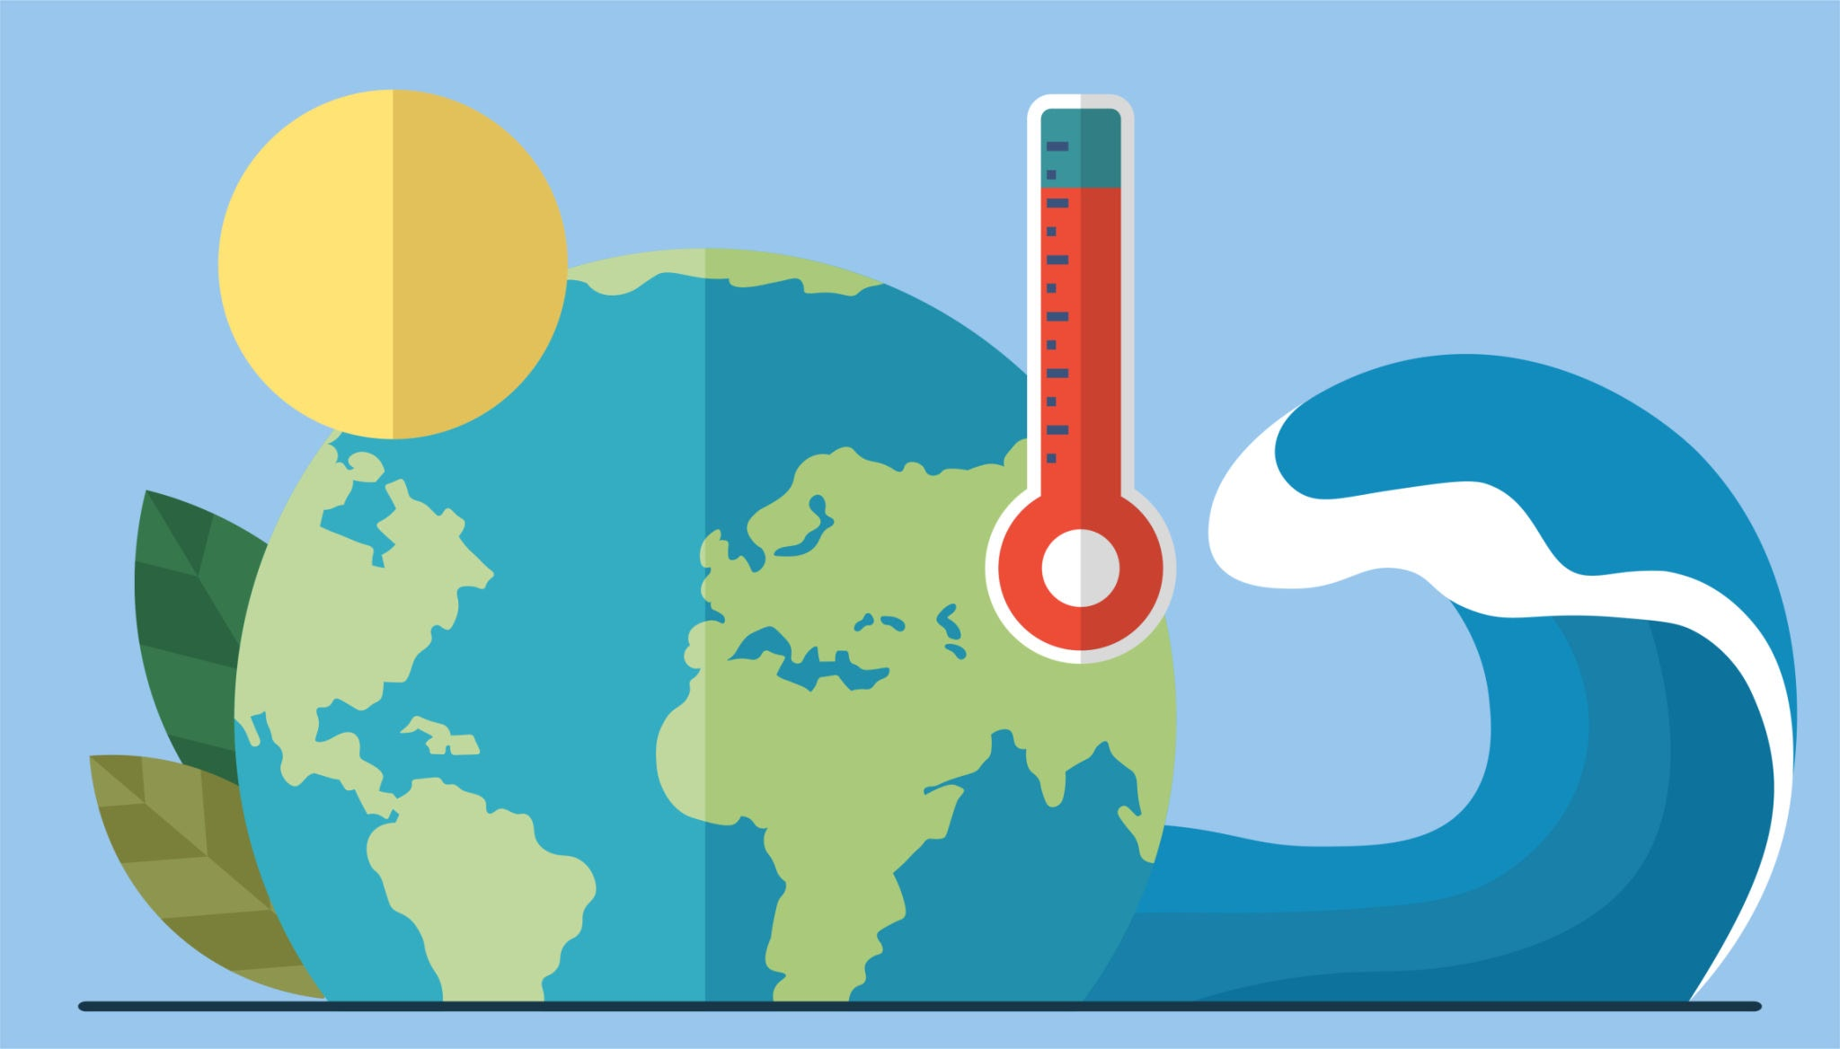
What is Climate Change?
What is a Flood?
Climate change is changes in Earth’s weather pattern and average temperatures over a long period of time.
A flood happens when water rises higher than normal and spills onto land where it doesn’t belong

Slide 10
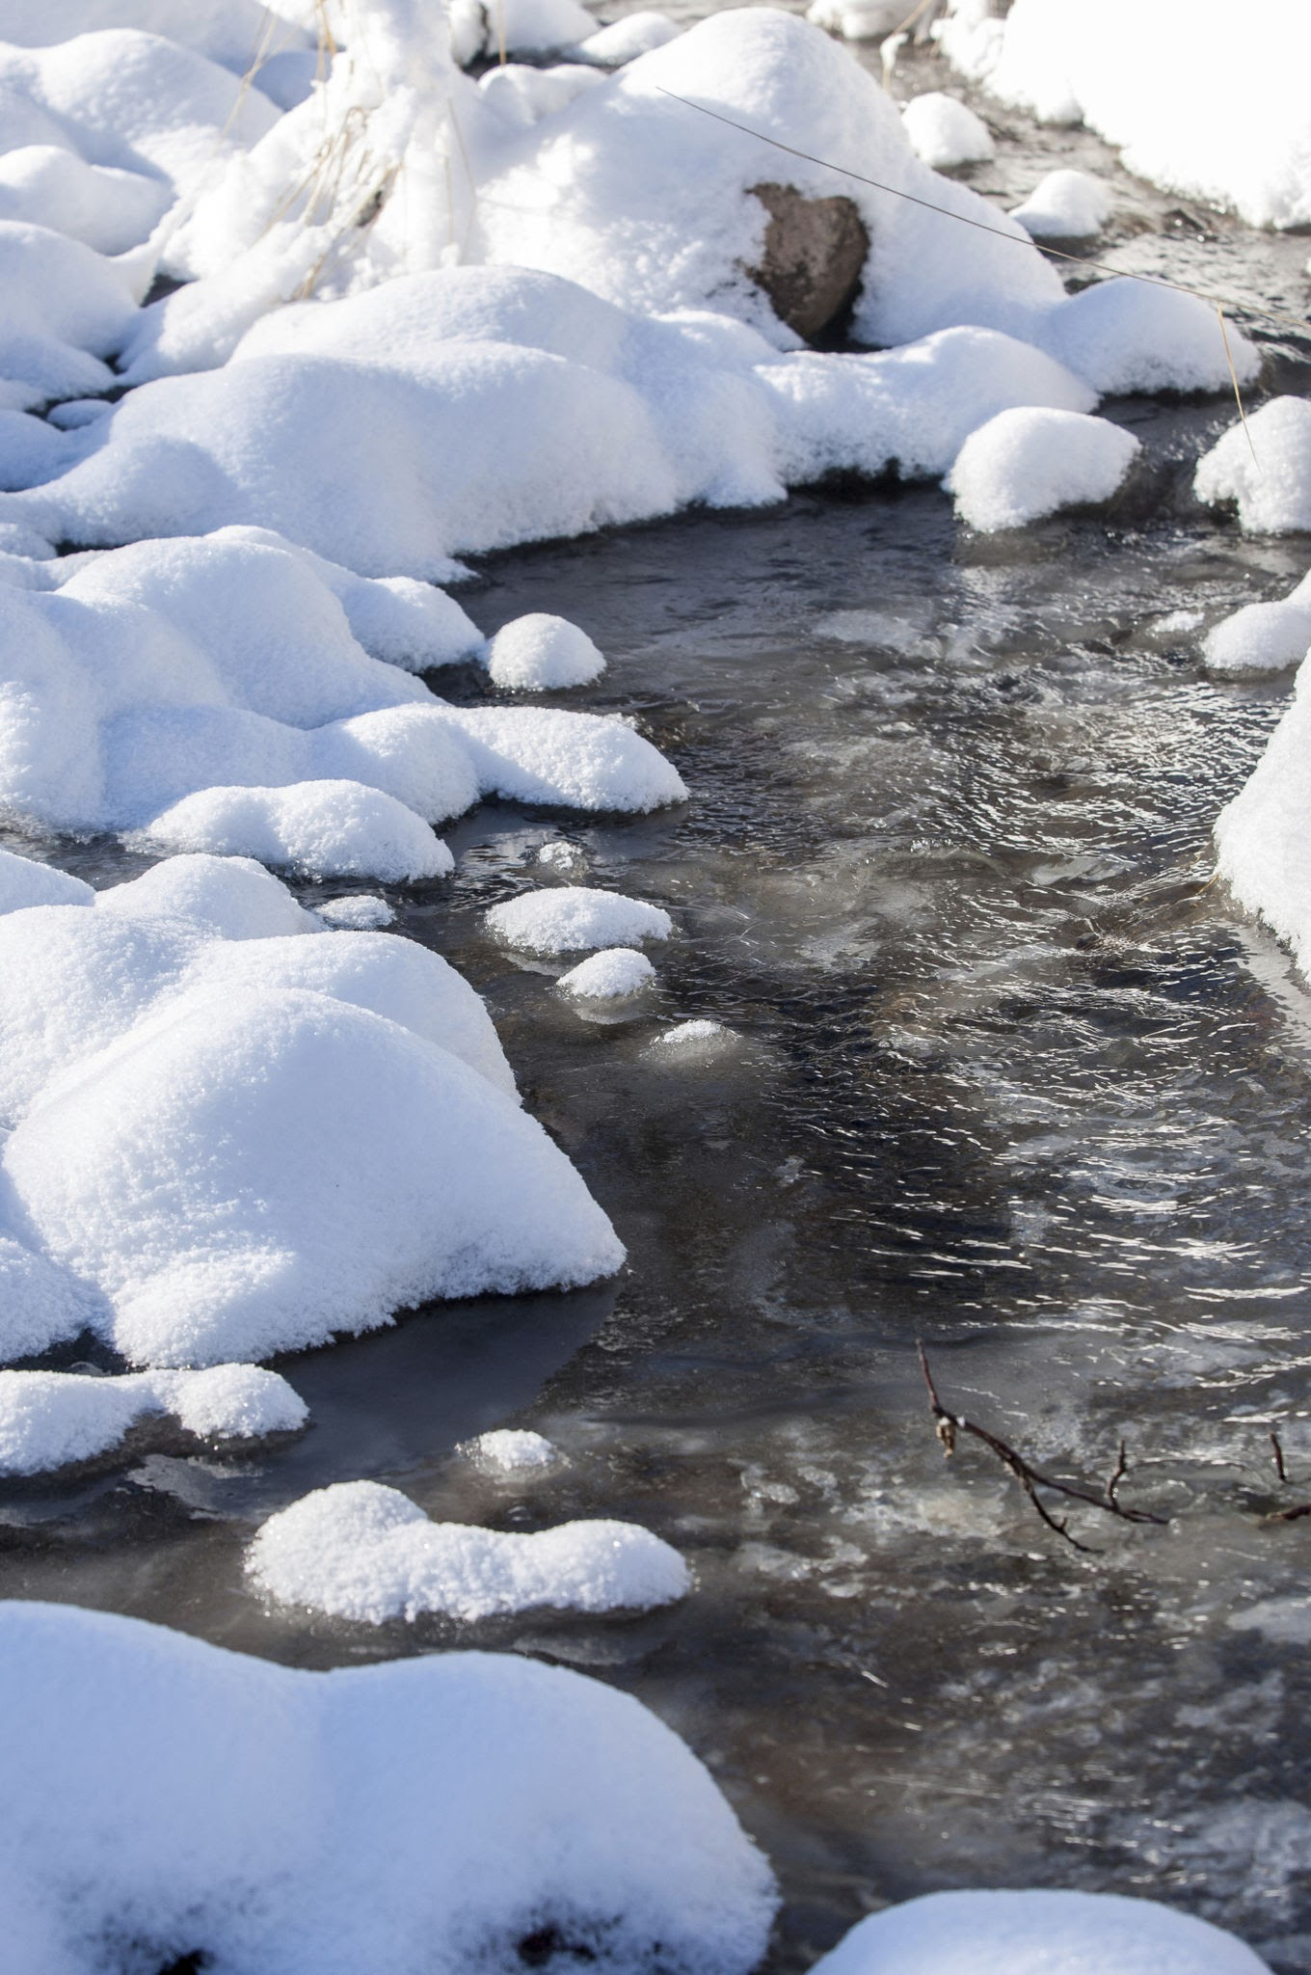
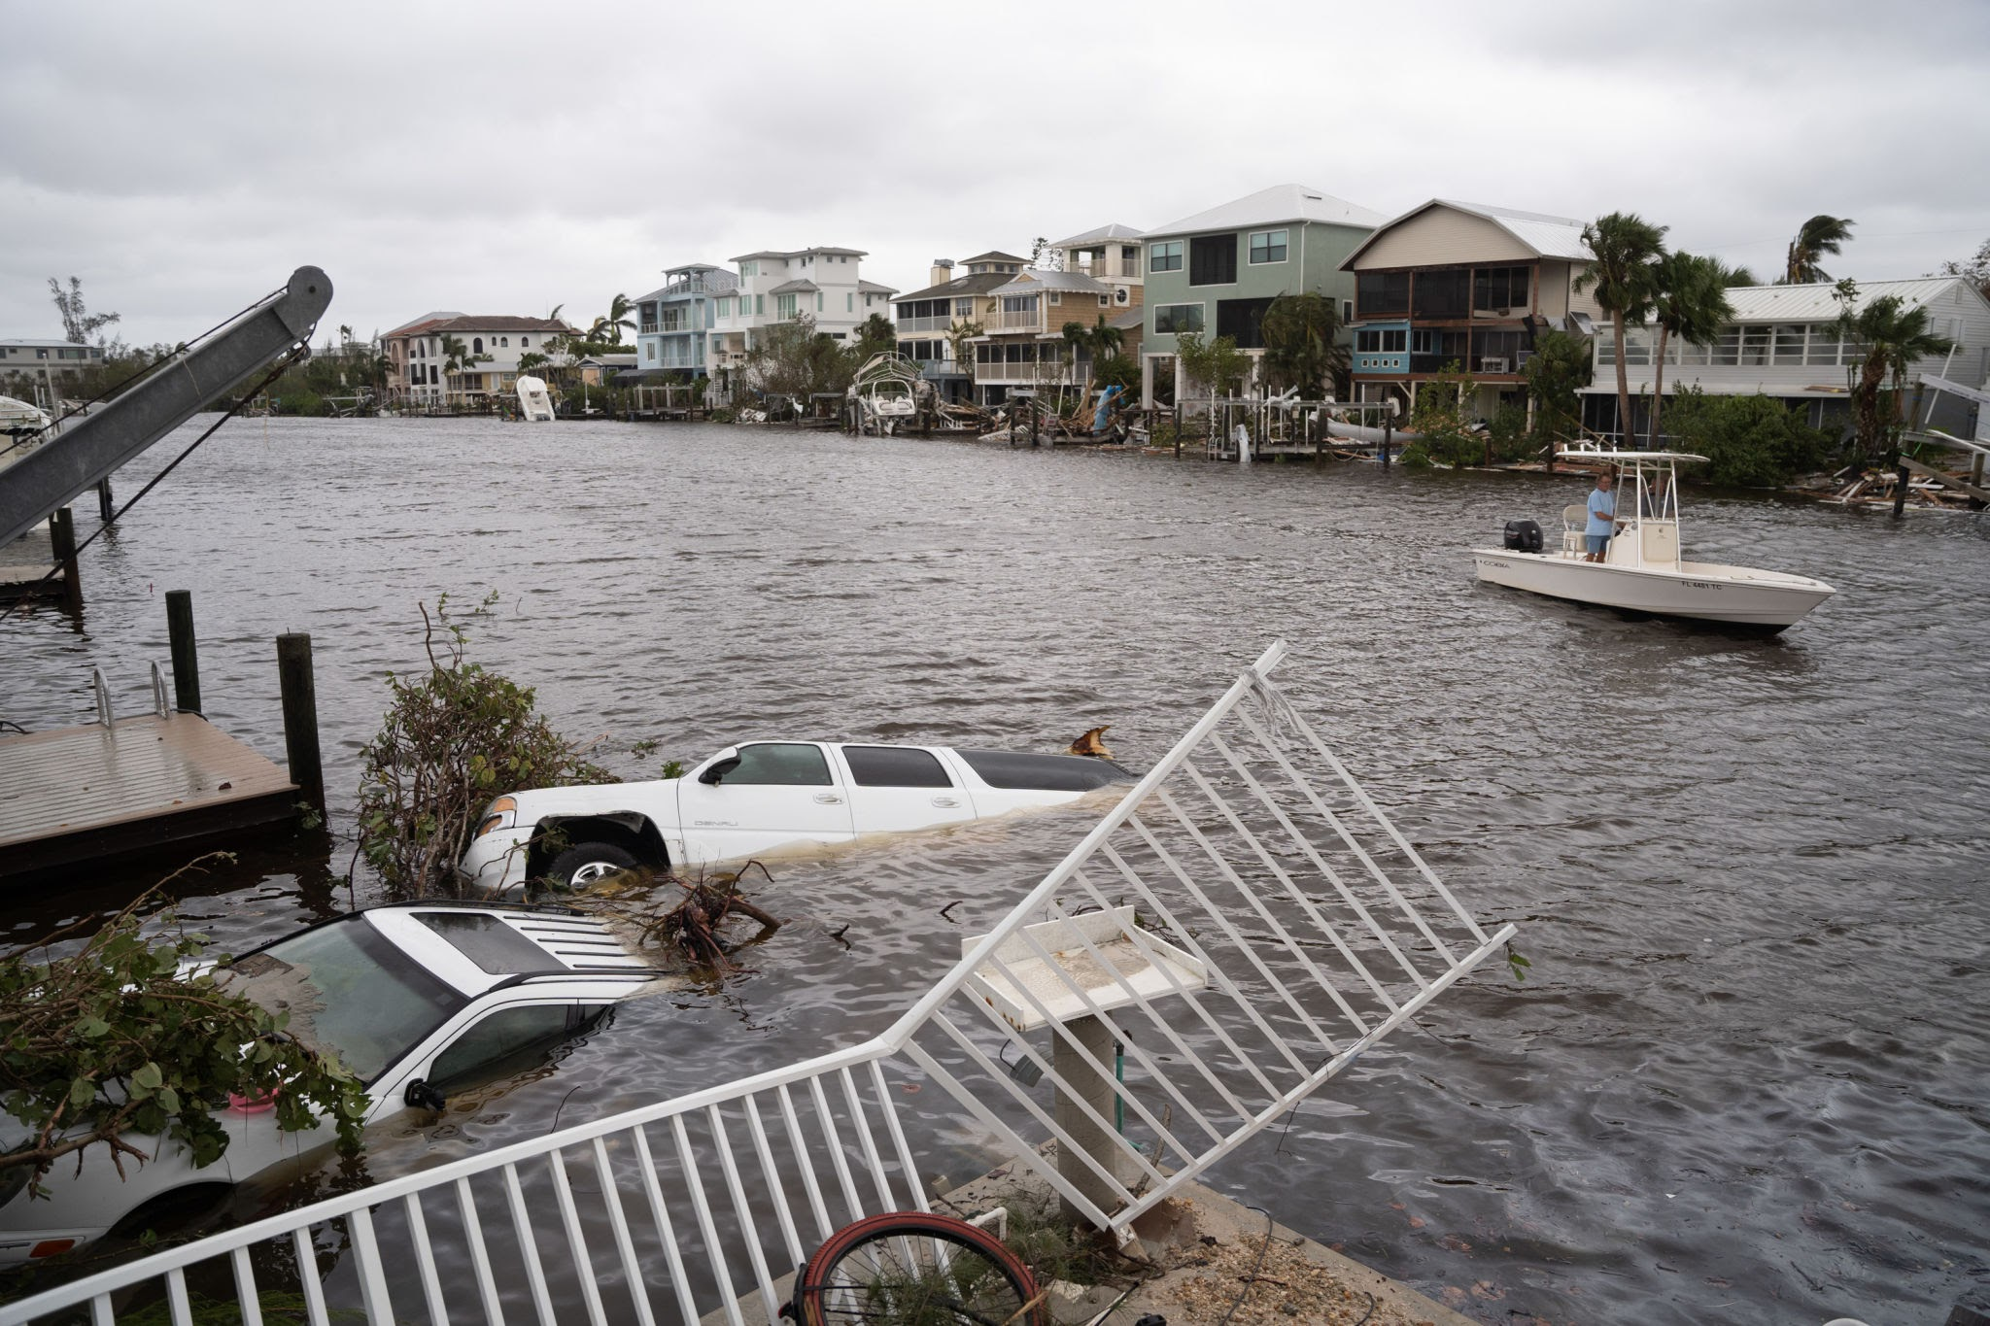
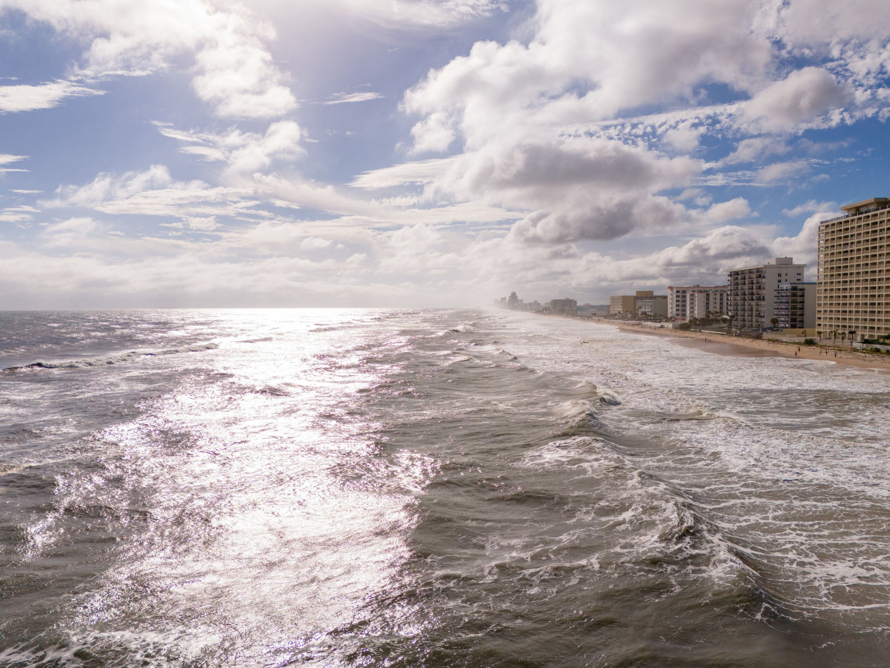
How does Climate Change affect Floods?
Climate change can cause storms to become more intense and stronger. This leads to more rainfall.
What impacts does this have:
Coastal flooding
Rising sea levels
Melting of snow and ice
Water levels rising
This means floods are becoming more severe and can impact many communities near water.

Slide 11
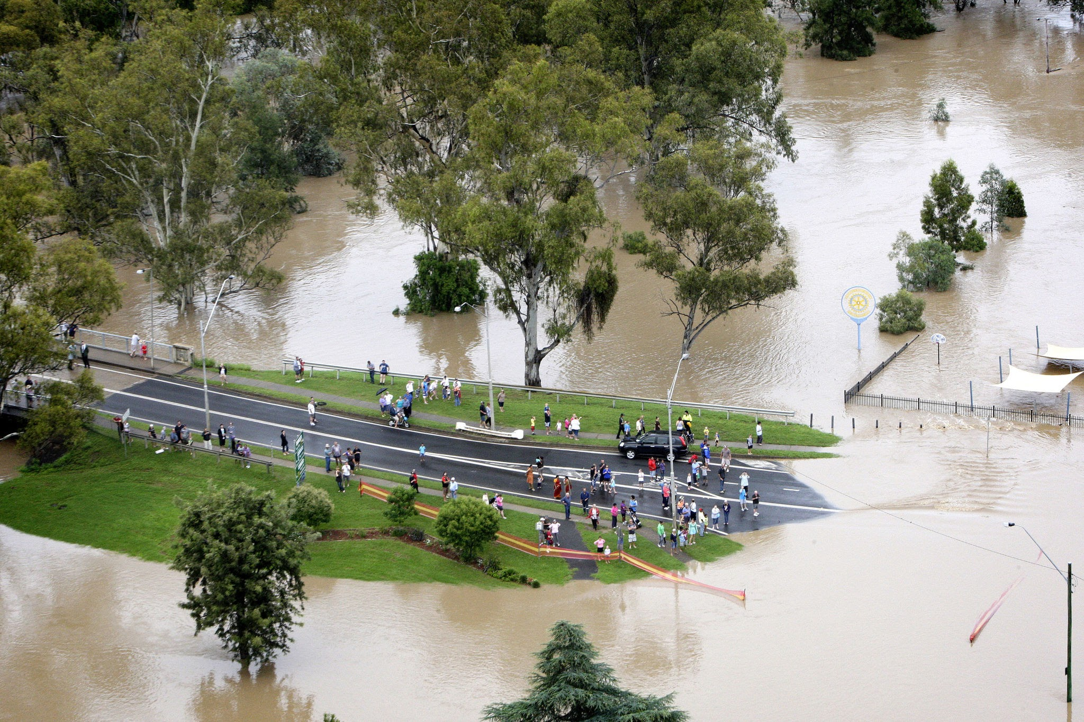
How Can We Measure Floods Caused by Climate Change in the Classroom?
Activity 1:
By using a water level sensor, we can explore how flooding impacts a city. Students can build a small city model inside a large tray or bin, adding toy buildings, roads, and parks. Once the city is ready, “rain” is poured over it using watering cans or spray bottles. The water level sensor is placed in low-lying areas, such as near “houses” or “streets.” As the water rises, students can record measurements and identify which parts of the city are most at risk. This helps students understand how geography and city planning can influence flood risk and safety.

Slide 12
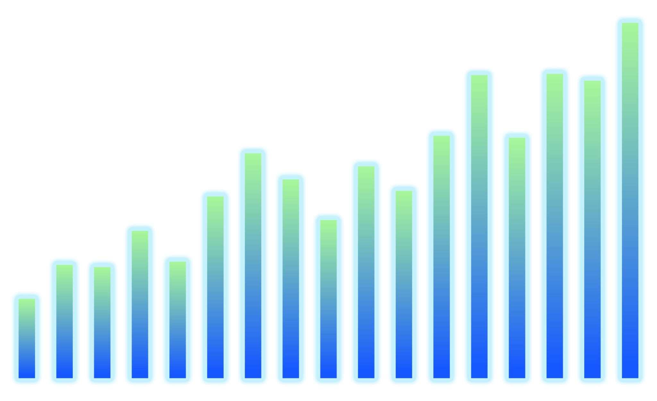
How Can We Measure Floods Caused by Climate Change in the Classroom?
Activity 2:
By using a water level sensor, we can see how storms change water levels over time. Create several short “storm” events by pouring in small bursts of water and recording the water level after each one. Students can then graph their results, noticing patterns such as sudden spikes during intense rain or slow increases over multiple smaller storms. This activity introduces them to the idea of tracking trends over time, which is a key part of climate science and flood forecasting.

Slide 13
How the Sensor Helps
The IO Rodeo water level sensor helps students:
Measure how quickly water rises during a flood
See how heavy rain affects rivers, lakes, or puddles
Collect data to understand how floods happen
Explore how climate change might cause flooding

Slide 14
Understanding Aquatic Habitats with a Water Level Sensor
Middle School Level

Slide 15
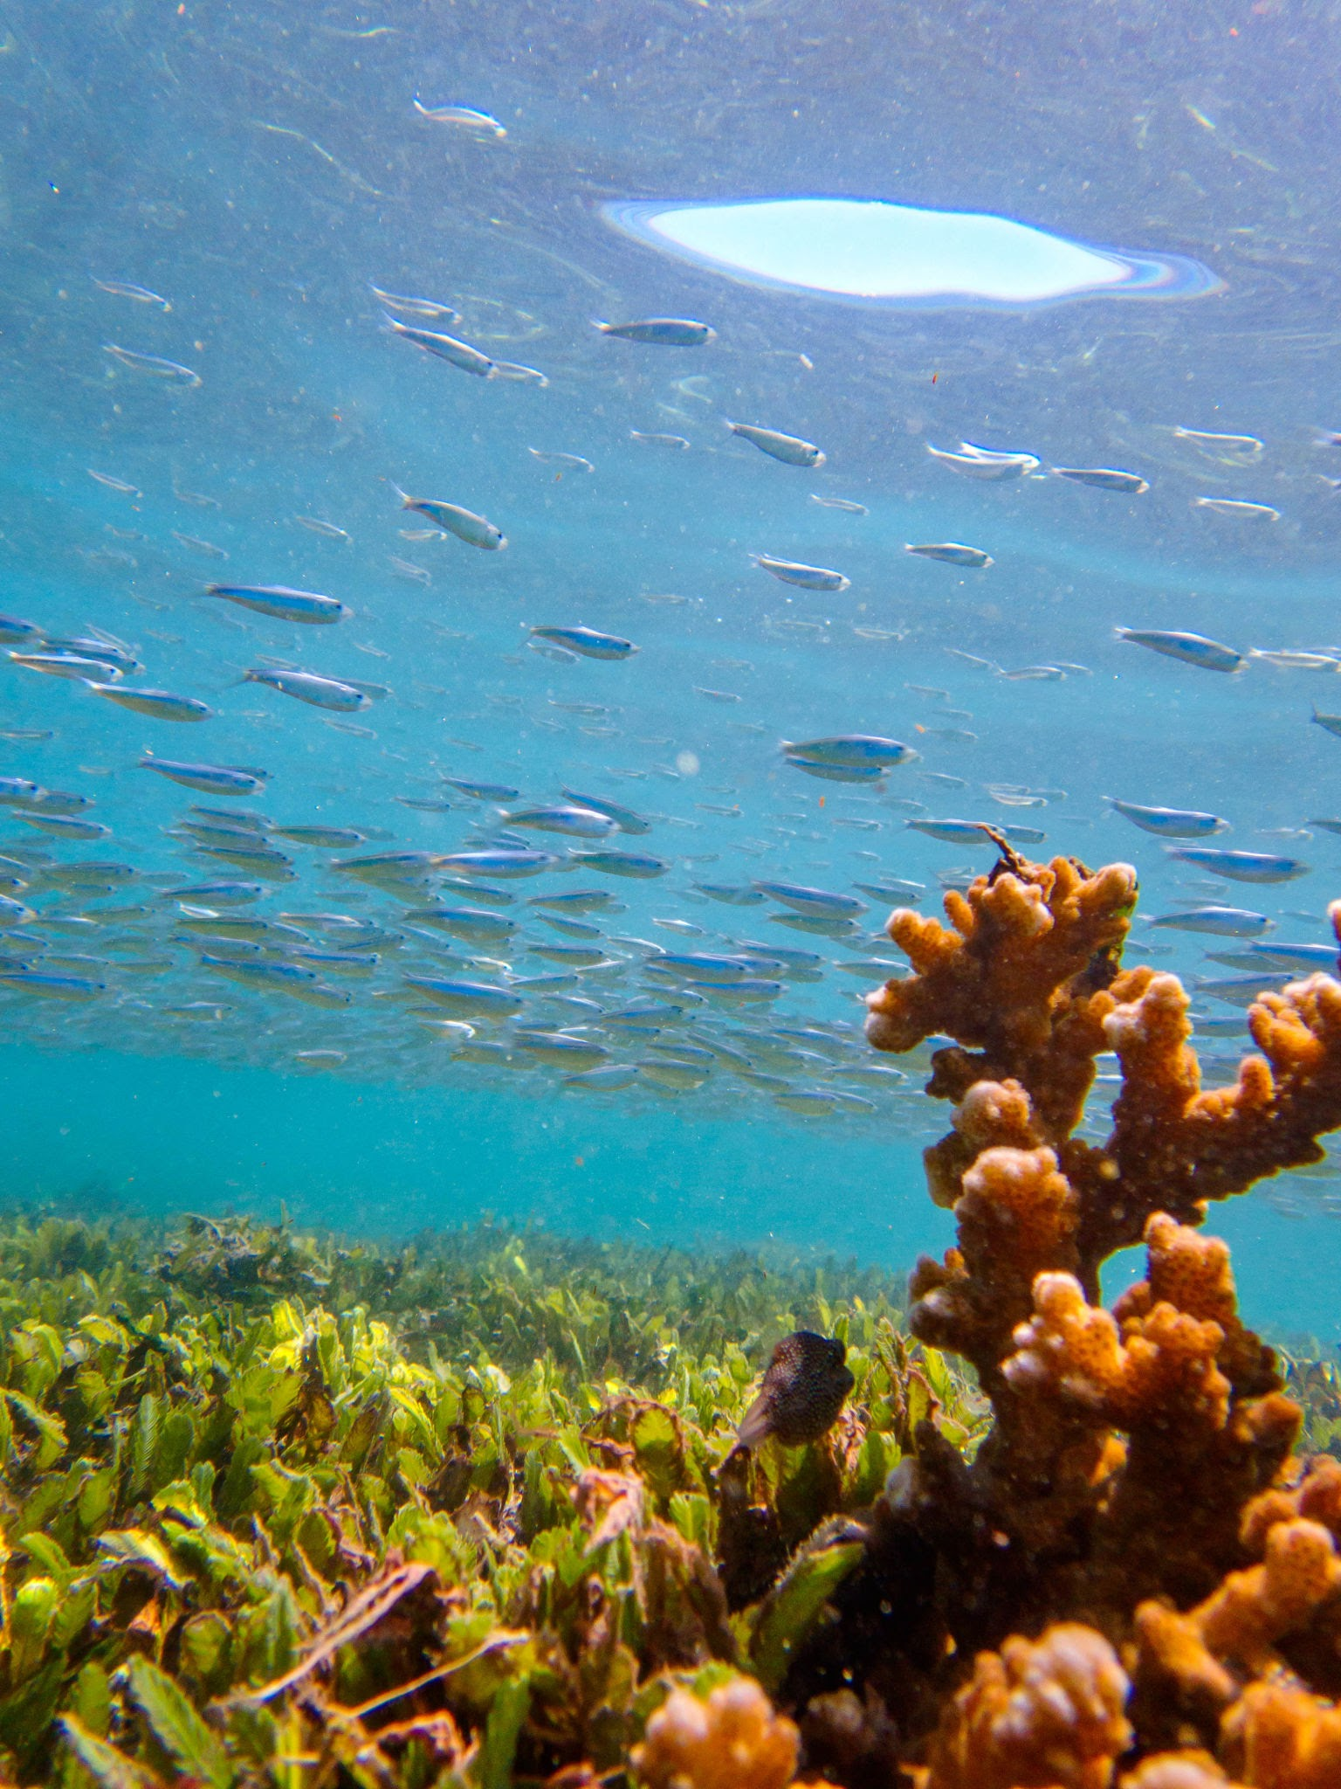
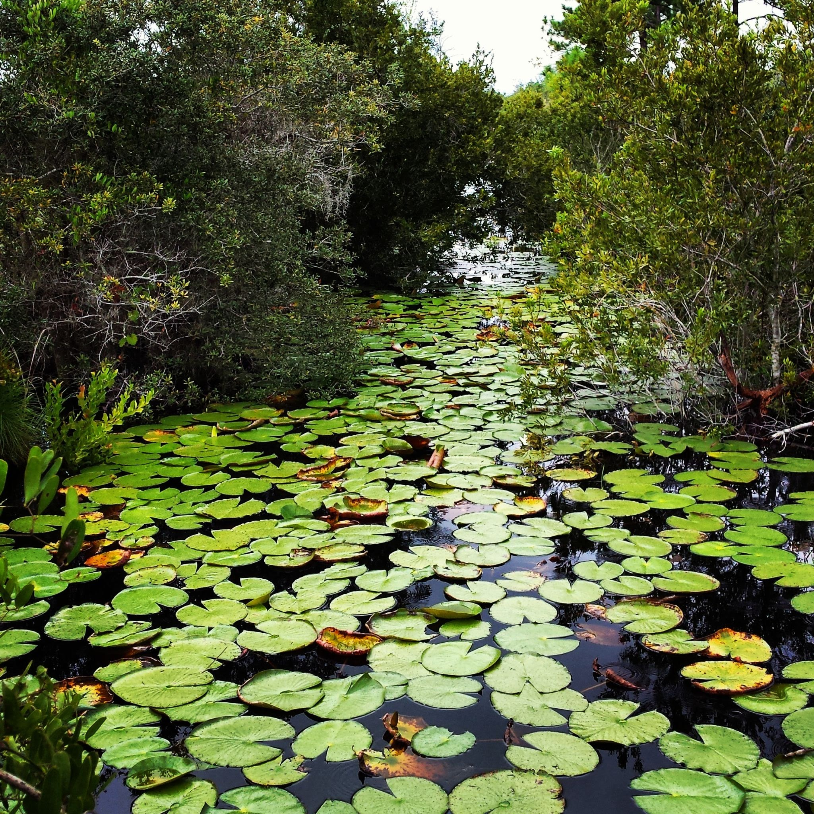
What are Aquatic Habitats?
Aquatic habitats are places where plants and animals live in water, like ponds, rivers, lakes, wetlands, and marshes.
There are many different types of aquatic habitats, and they all support different kinds of life, this results in a variety of habitats. The more variety of habitat the more variety of life, such as plants, animals, and other organisms.
This is a good example of biodiversity. Biodiversity means having many different kinds of living things in one place.

Slide 16
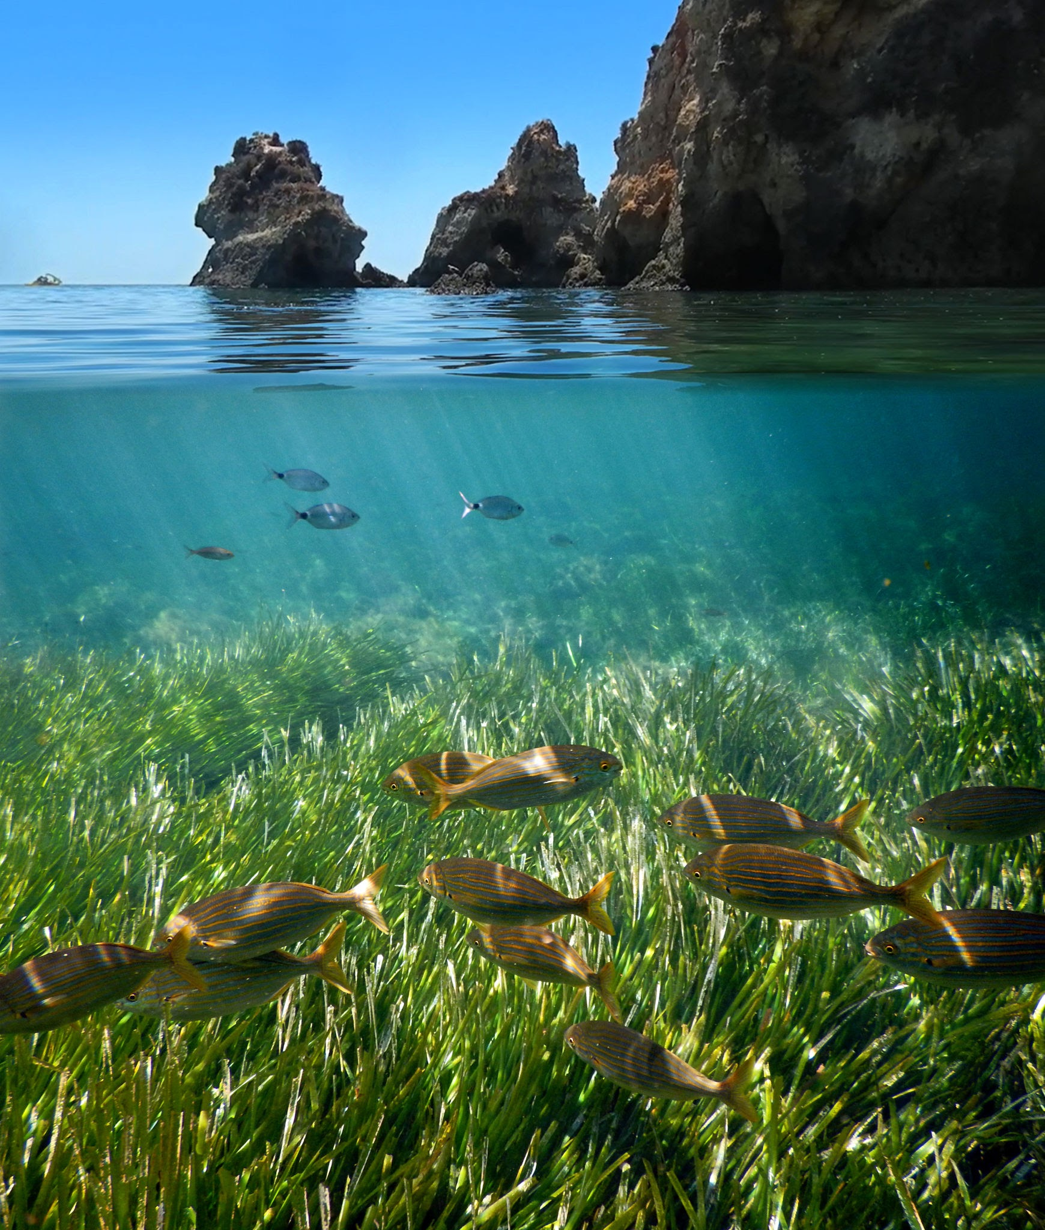
Why are aquatic Habitats important?
Aquatic habitats, like oceans, lakes, and rivers, are super important because they are homes for many plants and animals, and they help keep our planet healthy.
These habitats provide food, shelter, and places for creatures to grow and reproduce. They also play a big role in cleaning the air and water, and even help protect us from storms. For example, wetlands help soak up extra water during storms to prevent floods.

Slide 17
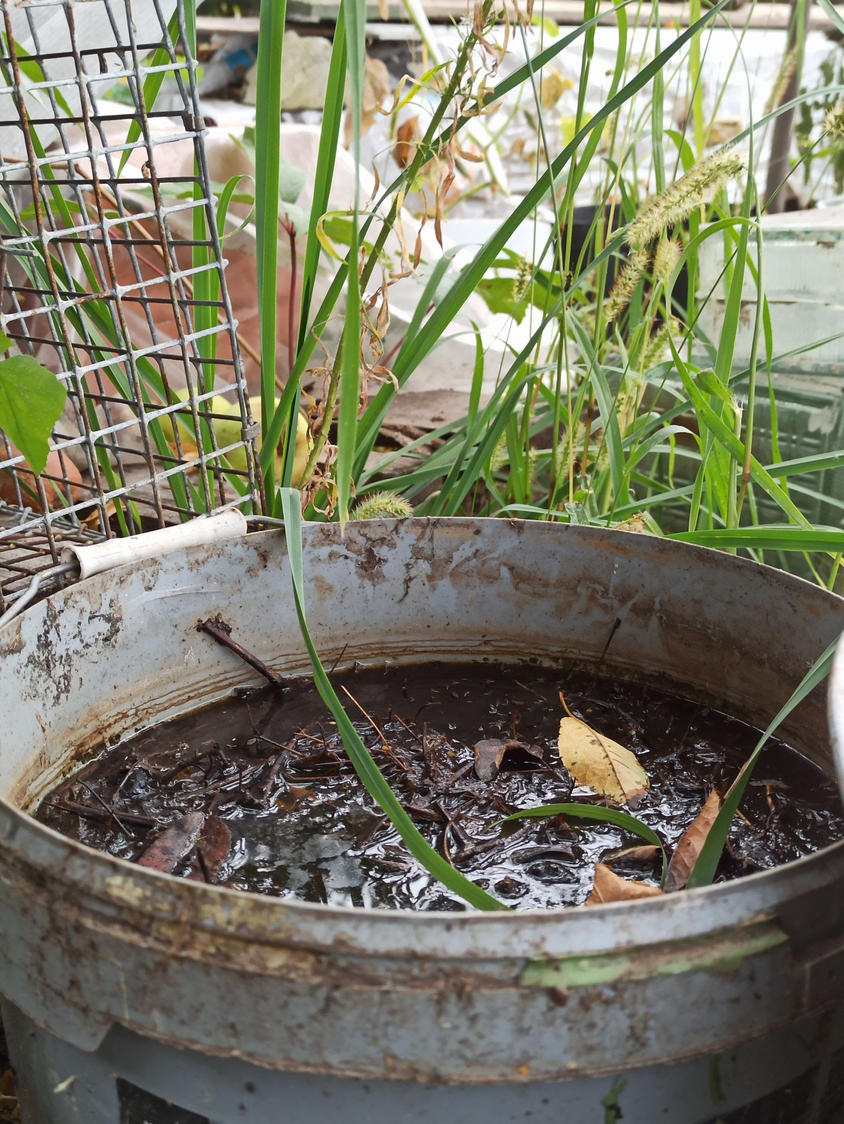
How Can We Measure the Changes of Aquatic Habitats in the Classroom?
Activity:
By using a water level sensor, we can see how wetlands store and release water. Students create a mini wetland in a plastic tub, complete with soil, plants, and a small “pond” area. They measure water levels before and after simulated rain to see how wetlands act like sponges, slowly releasing stored water.

Slide 18
How the Sensor Helps
The IO Rodeo water level sensor helps students:
See how water level rise or fall in wetland models
Explore how water changes affect fish, frogs, and plants
Measure how wetlands slow down floodwaters
Understand how human actions change aquatic habitats

Slide 19
Data Collection with a Water Level Sensor
Middle School Level

Slide 20
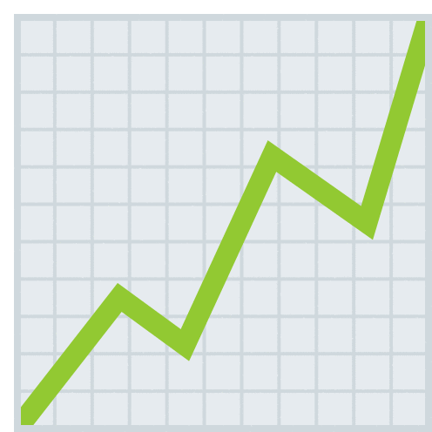
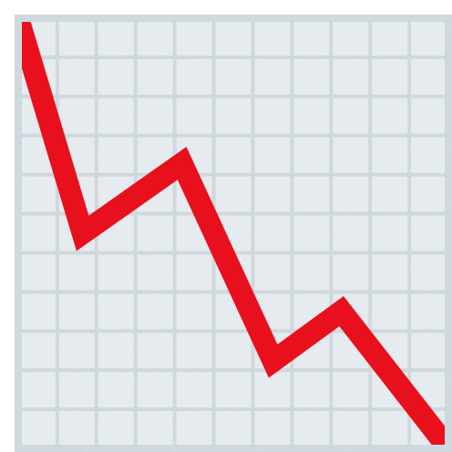
What is Data Collection?
Data collection means gathering facts and numbers to help answer scientific questions.
We collect data by asking questions, observing things, or doing experiments, and then we organize it so we can understand it better. This is an example of using the scientific method.
Scientists use the scientific method to test ideas and find out how things work!

Slide 21
What is the Scientific Method?
The scientific method is a way to investigate and understand the
world around us through a series of steps.
Making observations: Look at your surroundings
Asking questions: Come up with questions about the things you see
Research: Find out things that are already known about your question to gather information
Form a hypothesis: Make an educated guess or prediction of what you think will happen
Conduct an experiment: Design and conduct a test to see if your hypothesis is correct!
Analyze results: Look at the data collected from your experiment and see if it supports your hypothesis
Draw conclusions: After making a hypothesis, testing it, and collecting data you can now determine if your hypothesis was correct or not

Slide 22
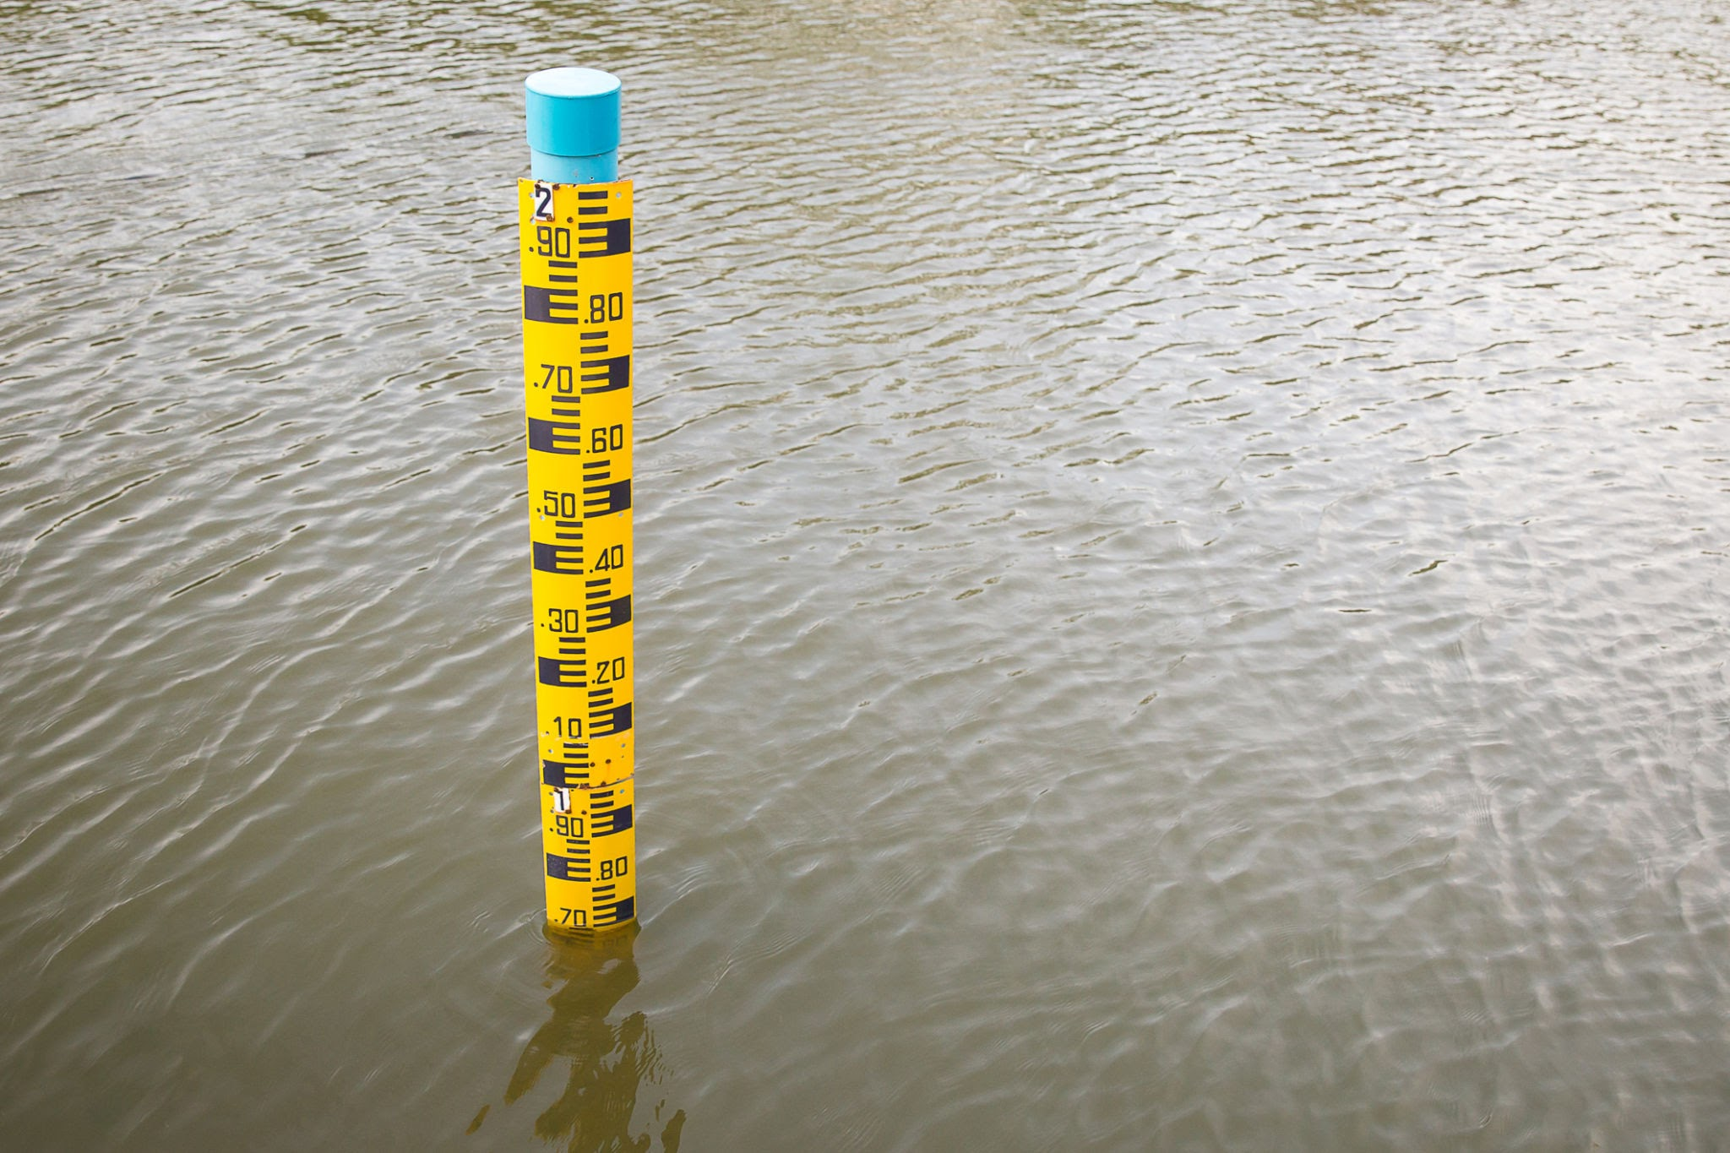
How Can We Collect Data in a Classroom?
Activity 1:
By using a water level sensor, we can practice collecting real-world data. Students measure water levels daily in a container or outdoor feature and record the results. They’ll then create line graphs to see changes over time. This shows how scientists monitor water patterns in real life.

Slide 23
How the Sensor Helps
The IO Rodeo water level sensor helps students:
Collect real numbers (data) about how high the water is
Test ideas (like how fast water rises during rain)
Make graphs and charts
Calculate mean, median, and mode with real measurements

Slide 24
Understanding Human Impacts Using a Water Level Sensor
Middle School Level

Slide 25
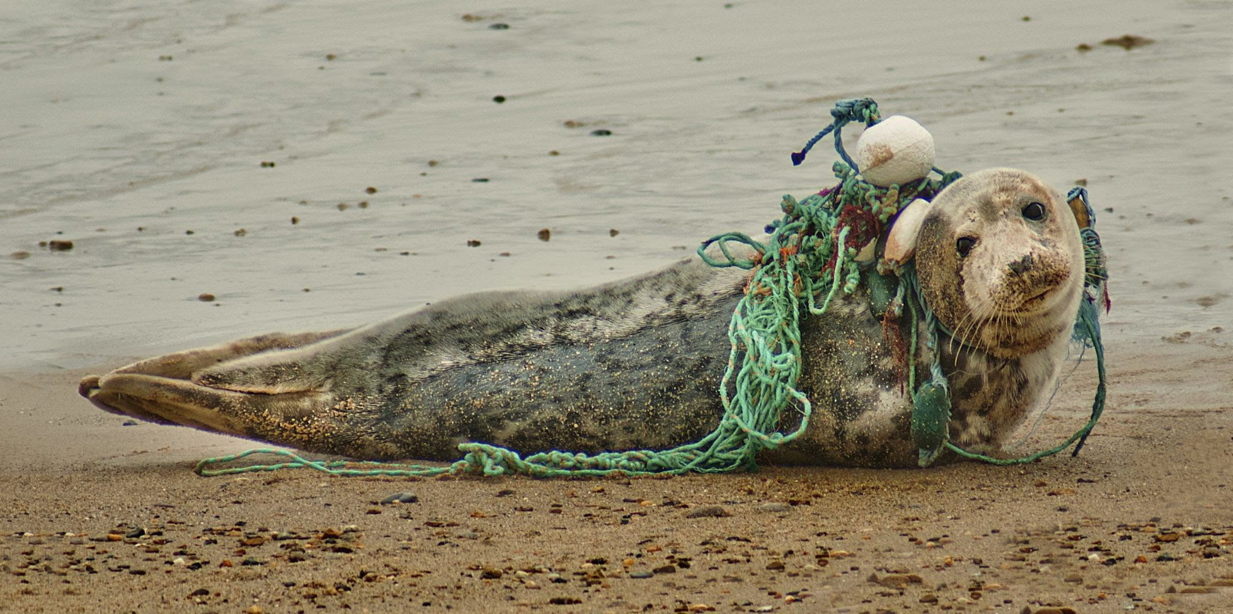
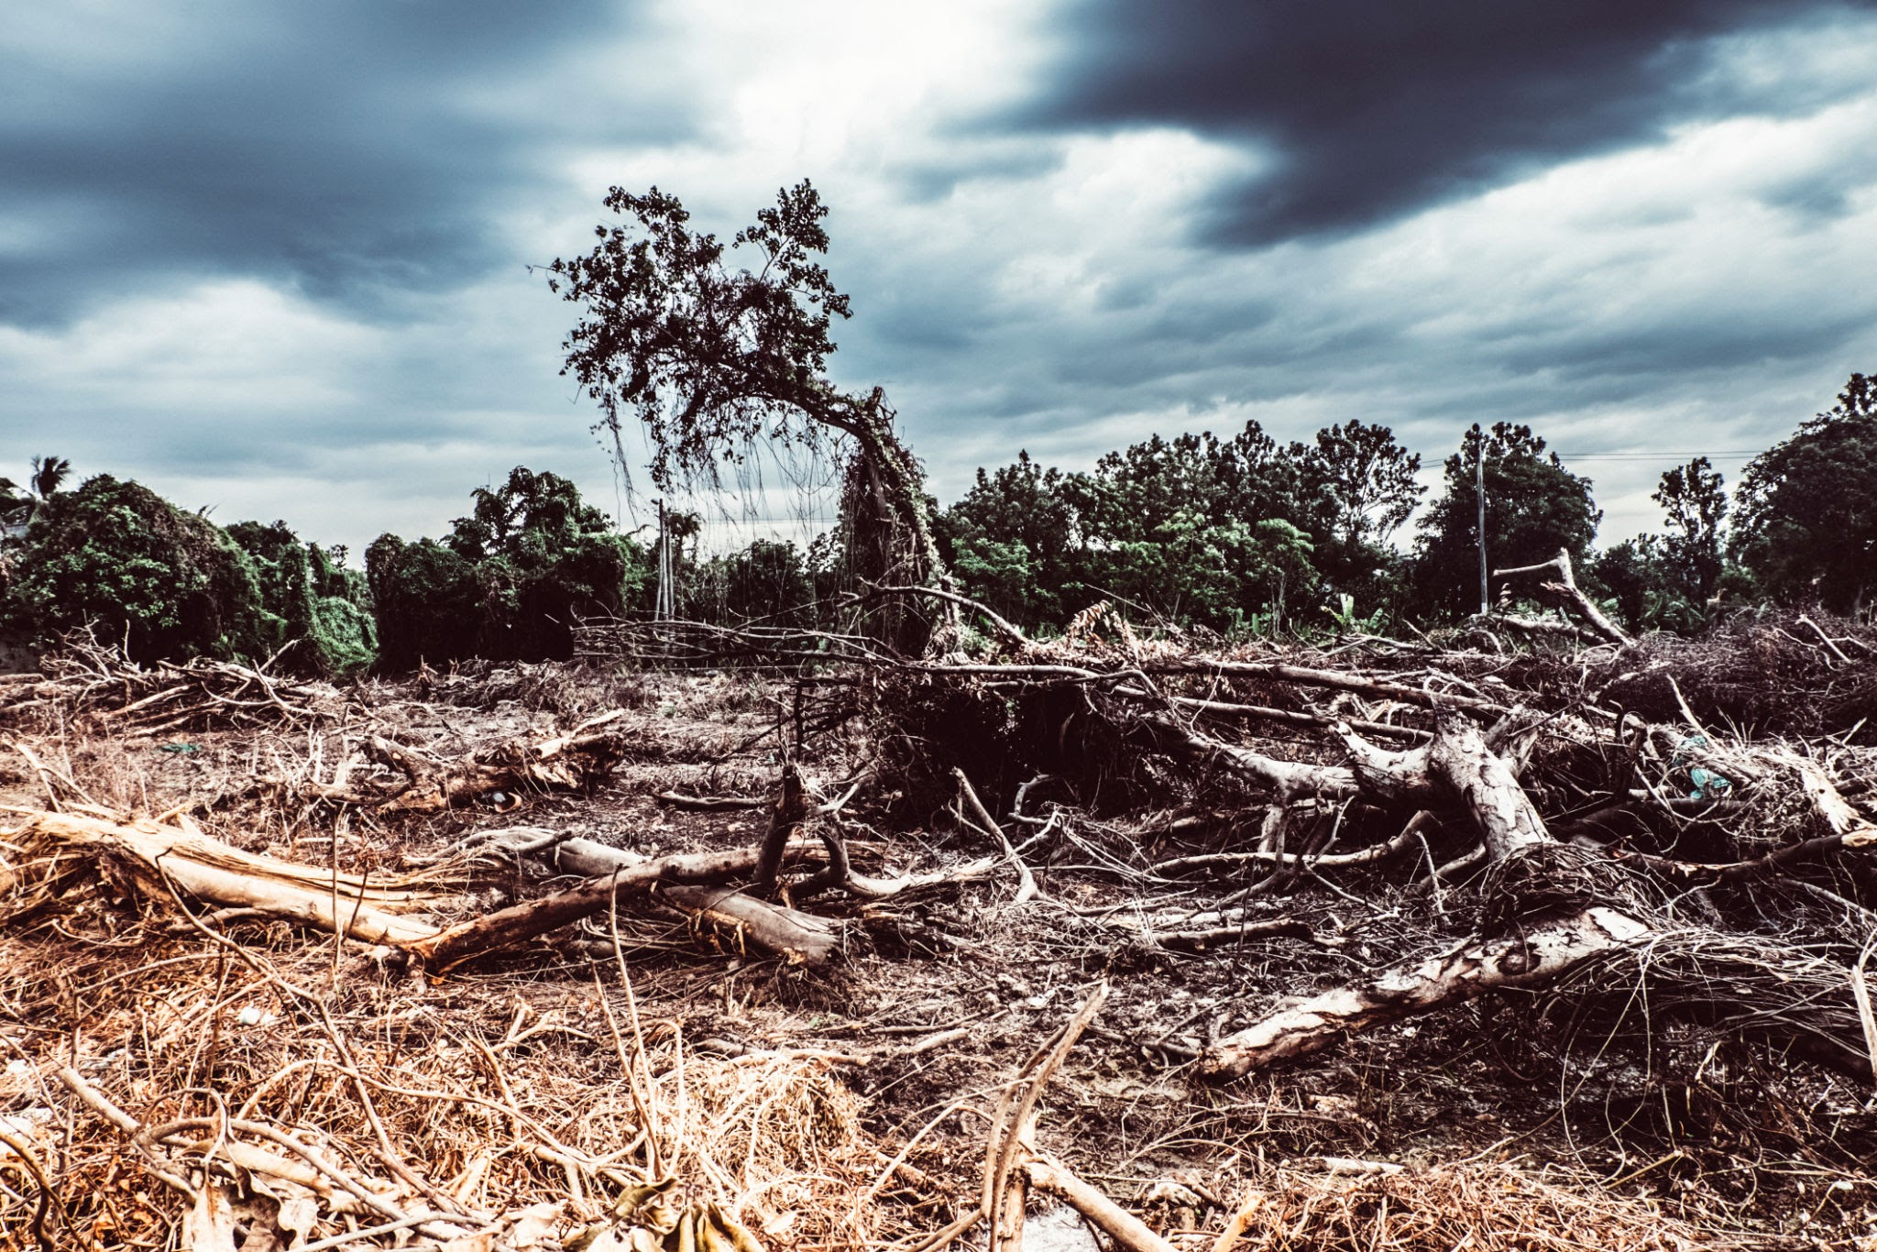
What are Human Impacts and how to they affect the Environment?
Human impacts on the environment are things like pollution, deforestation, and climate change. All of these examples are ways our actions have changed the world, and not in good ways. All of these examples have serious impacts on plant and animal life.

Slide 26
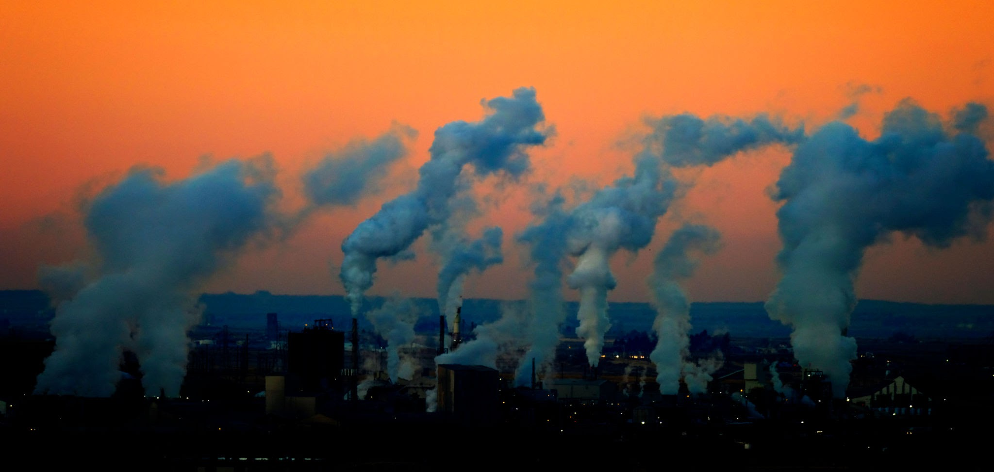
Human Impact Examples: Pollution
Pollution can harm living things by contaminating the habitat they live in. Some ways humans contribute to pollution is by littering, daily activities like driving cars, and by burning fossil fuels.

Slide 27
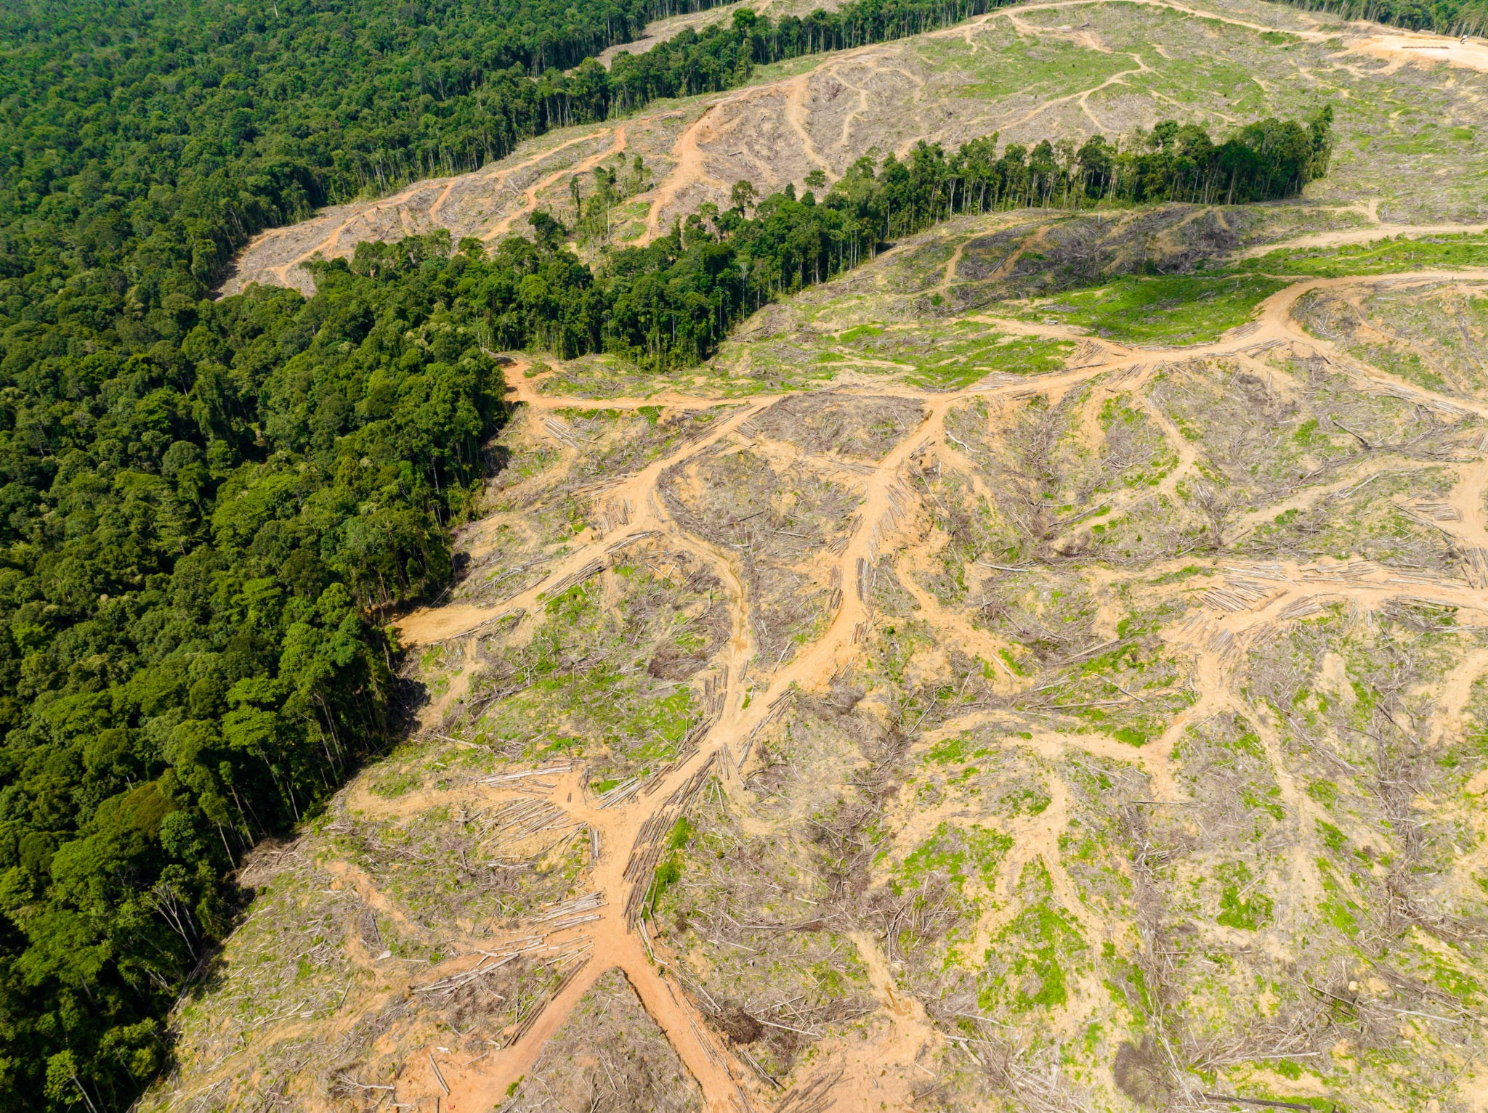
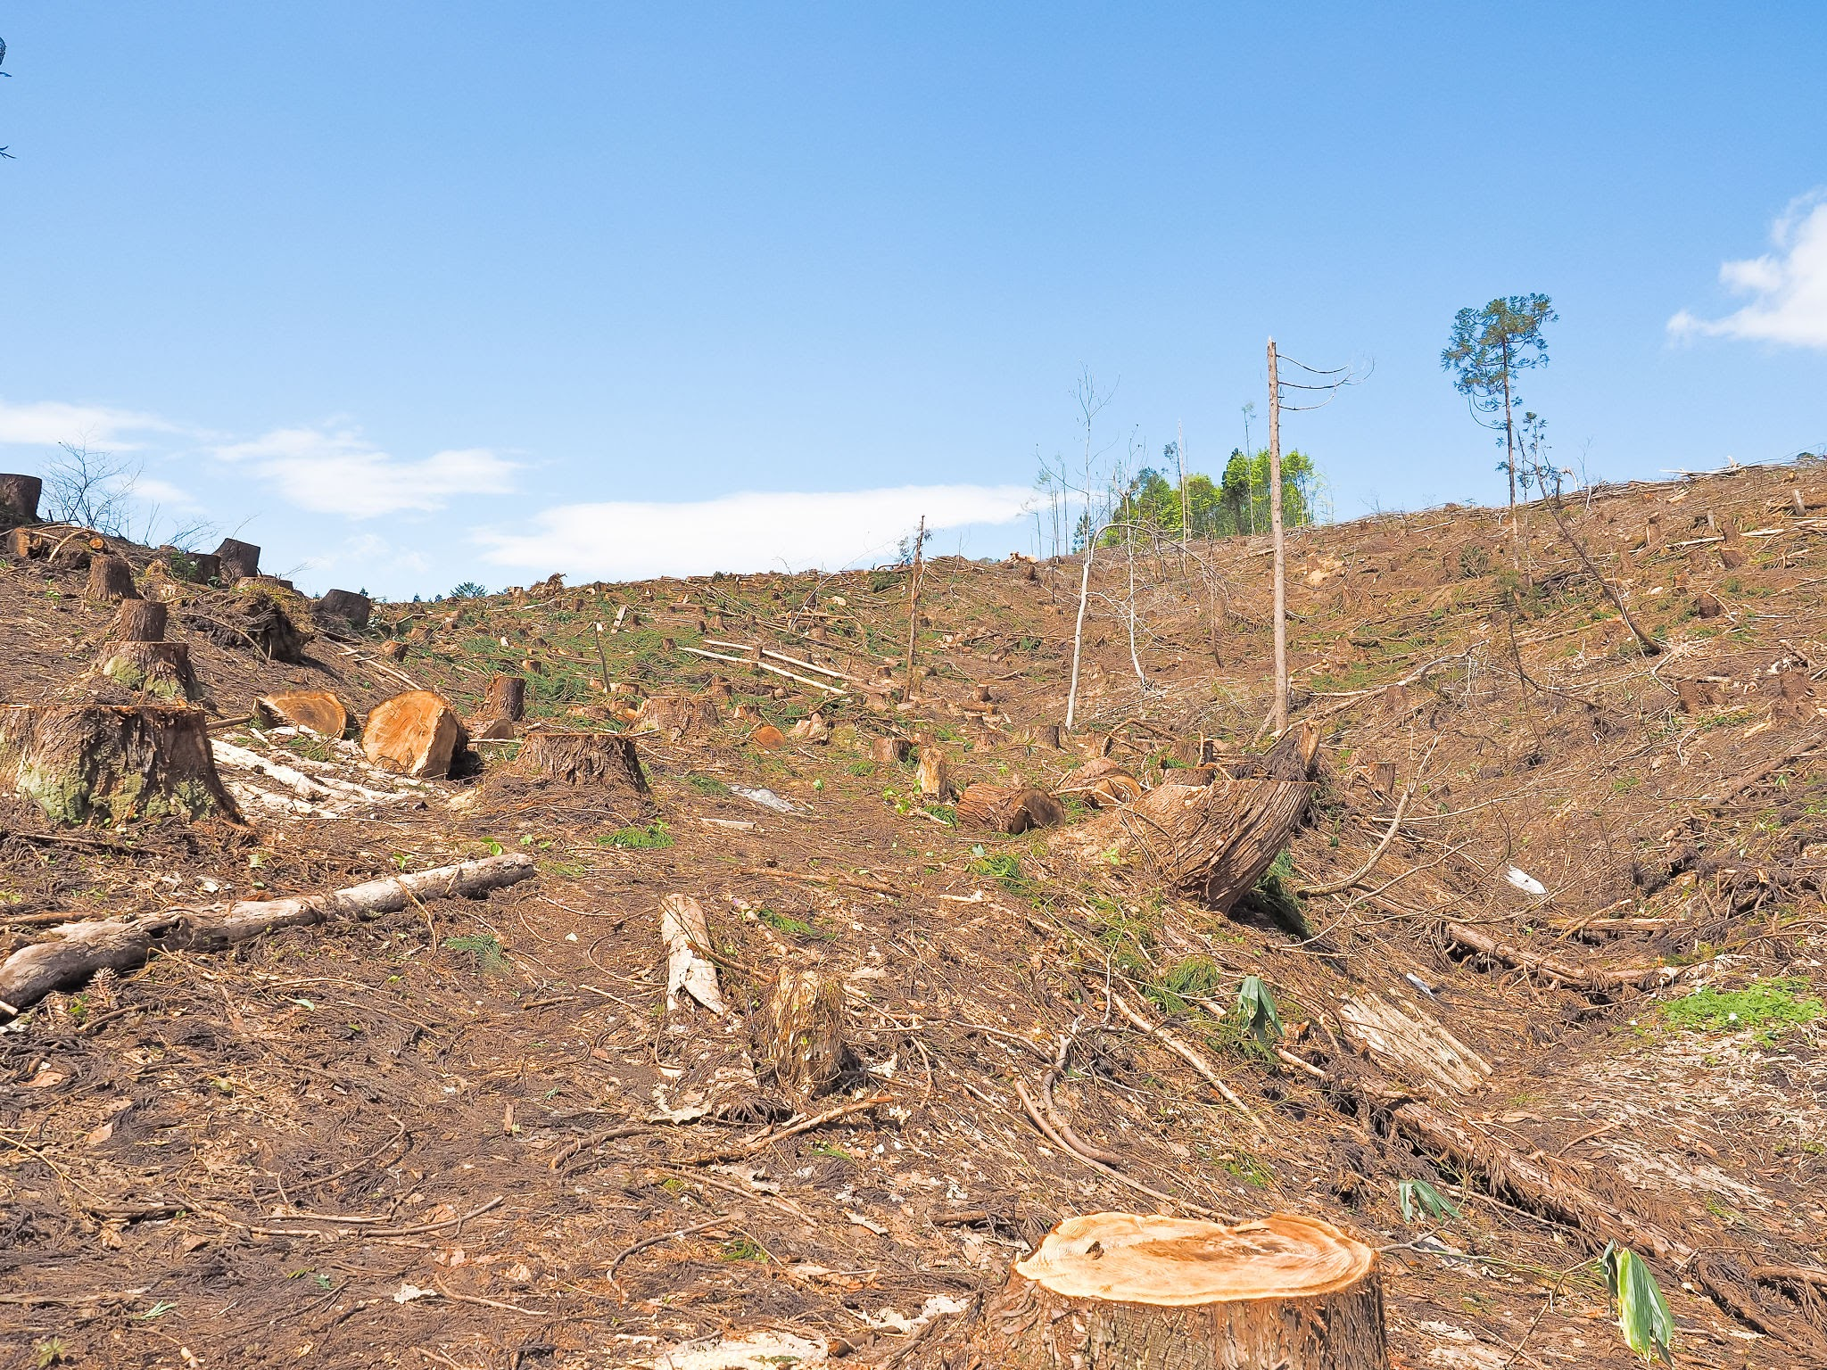
Human Impact Examples: Deforestation
Deforestation is the act of cutting down trees and taking away natural habitats. Trees help create oxygen and clean air for the environment, by taking them away it leads to more pollution in the air.

Slide 28
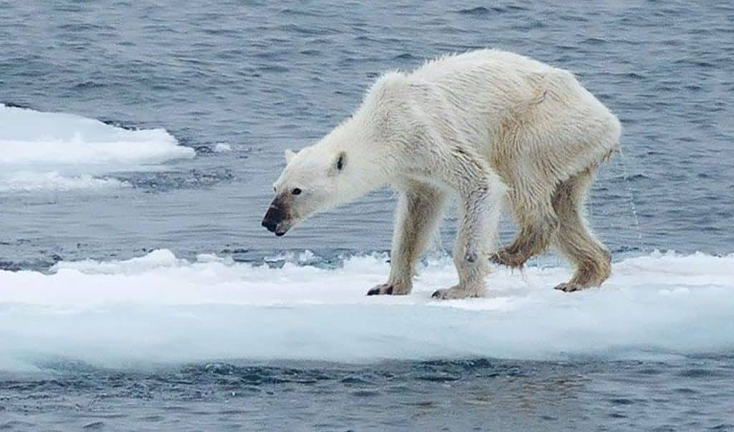
Human Impact Examples: Climate Change
Climate change is where the Earth is getting warmer because of all the pollution that gets trapped in the atmosphere. This causes ice and glaciers to melt, impacting polar habitats. It also causes the sea level to rise which impacts coastal habitats and people living at the beach.

Slide 29
How Can We Measure Human Impact in a Classroom?
Activity 1:
By using a water level sensor, we can track how pollution moves with water. Students create a small “city” in a tray and use colored water to simulate pollution. They measure how quickly it spreads during simulated rainfall.
Activity 2:
By using a water level sensor, we can test pollution prevention methods. Two trays are set up, one with vegetation and one without. Students simulate rain and compare how much “polluted” water flows out of each, learning how plants help trap and filter contaminants.

Slide 30
How the Sensor Helps
The IO Rodeo water level sensor helps students:
See how water levels change during storms
Discover how fast pollution might spread in water
Compare clean water vs. polluted water experiments
Learn how cities can manage stormwater to protect rivers

